Slide 1

SQL- Driven Loan application automation
By midhun chakravarthi

Slide 2
Introduction to sql
SQL (structured query language) is a standard programming language designed for managing
  and manipulating relational database.It is used to perform tasks such as querying data, updating records, inserting new data, and deleting existing data in a database.
  Key features of SQL:
  Data retrieval: SQL allows users to query database using the SELECT statement to retrieve specific data
  Data manipulation: SQL enables operations like inserting (INSERT),updating (UPDATE),and deleting
  (DELETE) records.
  3.Data Definition: SQL provides commands like CREATE , ALTER , and ‘DROP’.
  4.Data Control: ensure access to the data (grant and revoke)
  5.Transaction control: ensure data integrity using(begin , commit , rollback).

Slide 3
Introduction to MYSQL WORKBENCH
MYSQL workbench is a powerful graphical tool for managing MYSQL databases. It allows you to design , develop, and administer databases with features like:
SQL query development and execution.
Database design using visual ER diagrams.
User management , backups and sever configuration.
Data migration between different databases.
Monitoring and performance tuning.`

Slide 4
INTRODUCTION TO THE PROJECT
THIS project aims to analyze customer income and loan status using a structured SQL based system. The goal is to develop a database that efficiently stores and processes customer loan financial details, such as income levels , loan amounts , and credit (CIBIL) scores . through SQL queries and procedures, the project classifies customers by income, calculates monthly and yearly interest , and assesses loan eligibility based on CIBIL scores.
Customer income classification : organizing customers based on income and property type.
Loan status management: handling loan amounts , terms, and credit score evaluations.
Triggers and procedures: automating updates to loan status and credit risk analysis.
Data insights : analyzing customer segments , loan performance and interests calcuations.

Slide 5
Purpose of the project
Manage and process customer loan application data efficiently.
Automate loan application validation using SQL triggers .
Categorize customers based on income, loan status , and CIBIL score.
Generate insights such as high-value customers and high CIBIL score customers.
Streamline data retrieval and improve decision-making for loan approvals.
Ensure data accuracy through the use of SQL commands , joins, and stored procedures.

Slide 6
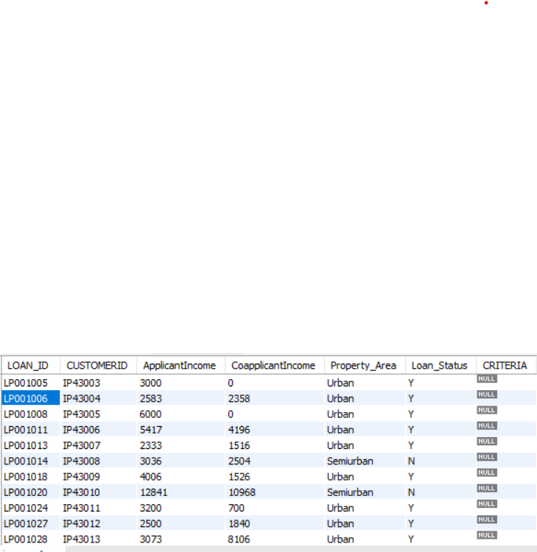
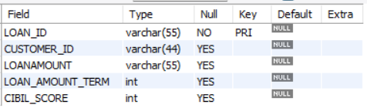
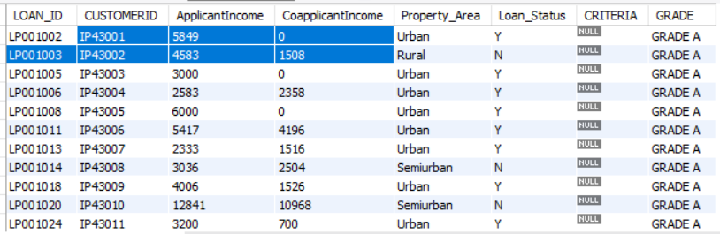
Tables used 1

Slide 7
Tables used 2

Slide 8
Customers income and region
Setting customer criteria based on income:
A new table was created to categorize customers into income –based classes:
Grade A:customers with an income greater than 15,000.
Grade B:customers with an income between 9,000 and 15,000
Middle-class : customers with an income below 5,000 .
Low-class: customers with an income below 5,000.
this classification helps in analyzing and prioritizing customers based on their financial status.
2. Applying interest rate based on income and region:
Monthly interest rates were assigned to customers based on their income and geographical region
For income< 5,000,rural, semi-rural , urban on area had different rates.
Set a default interest rate for other cases.
This step ensured that interest rates were tailored to the financial standing and location of the cost adding a dynamic element to loan processing.

